Slide 1
Make Europe the new Global Powerhouse for Startups
#Accelerate_EU_tech_ecosystem
The event is held under the patronage of European Committee of the Regions and Commissioner Mariya Gabriel, Member of the European Commission.

Slide 2
The challenges of the European tech community worldwide
01
The efforts so far are scattered and not connected
02
The European tech startup communities are not well connected to the world’s major tech startup hubs
03
Startups in provincial areas have no or limited access to great startup resources (investors, clients, experts etc.)

Slide 3
Open online programs for every
European tech startup founder
Inspire
Educate
Connect

Slide 4
Overview of
the programs
People
20000+ startup founders
Startups
The biggest project for EU tech startups, connecting hundreds of early-stage startups with the brightest minds of diaspora - established founders, well known investors, great engineers, academics and experts – through national online massive programs open to every EU country.
10000+ tech startups
European founders
Exclusive for European founders

Slide 5
Timeline
Total duration of programs being live – 5 months.
Registrations
open
Online
events
6-week national
programs
Investors’
sessions
Closing Event
1
2
3
4
5
January
Late Jan. - Feb.
March - April
April
May
Open call to EU startups
2 promo online events
At the same time, 6-week programs for each country start through our platform with 10000+ EU tech startups onboard
Connect early stage startups with EU angels
Final online event to share the outputs of the programs

Slide 6
Bringing the EU tech community together
Private sector
Research & academia
EU corporates
EU universities
Multinationals with EU Executives
RnD centers in EU
VCs and EU angel investors
Student entrepreneurship clubs
Community
Institutions
EU incubators & accelerators
Chambers of commerce
Entrepreneurship organizations in EU
EU embassies worldwide
Media in EU & abroad

Slide 7
The pillars of the 6-week open online programs
01
Workshops
04
Educational content
Weekly online sessions covering 6 topics that are most valuable to an early-stage startup founder
Each team receives weekly a curated list of educational content
02
Office hours
05
Special offers & discounts
Recorded weekly Q&A talks with experts, startup founders and investors
Coupons and free credits for servers, domain, ads credits, etc.
03
Community
06
1:1 online meetings
All teams interact through forums with the best EU engineers, Business Developers, experts, etc.
Access to online meetings with EU investors, corporates, lawyers & accountants

Slide 8
Our amazing team
Thanos Paraschos
Organizer of the European Startup Universe
Dimitris Dimosiaris
Co-Founder of Founderhood
Panagiotis Kokmotos
Project Manager
Eleni Farantaki
Marketing / Operations
Aleksandra Krzyzanowska
ESU Country Organizers’ Manager
Berton Guillaume
PR & Media Manager
Catalina Tatuc
Content Creator
Lukasz Paszke
Social Media Manager
Dimitra Dimitrakopoulou
Social Media Manager
Andrea Napolitano
Sales/BD
Manos Siganakis
Sales/BD
George Petsas
Sales/BD
Jose Manuel Paredes
Fundraising Manager
Leo Olivier
IT Department
Penny Karakosta
IT Department

Slide 9
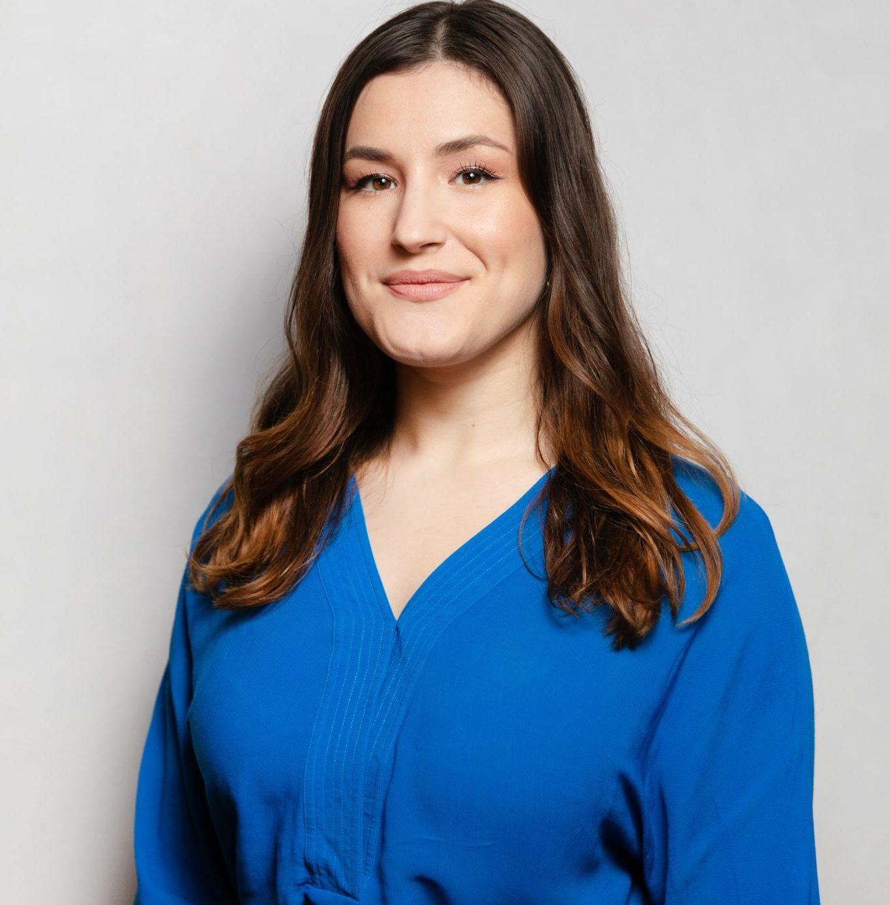
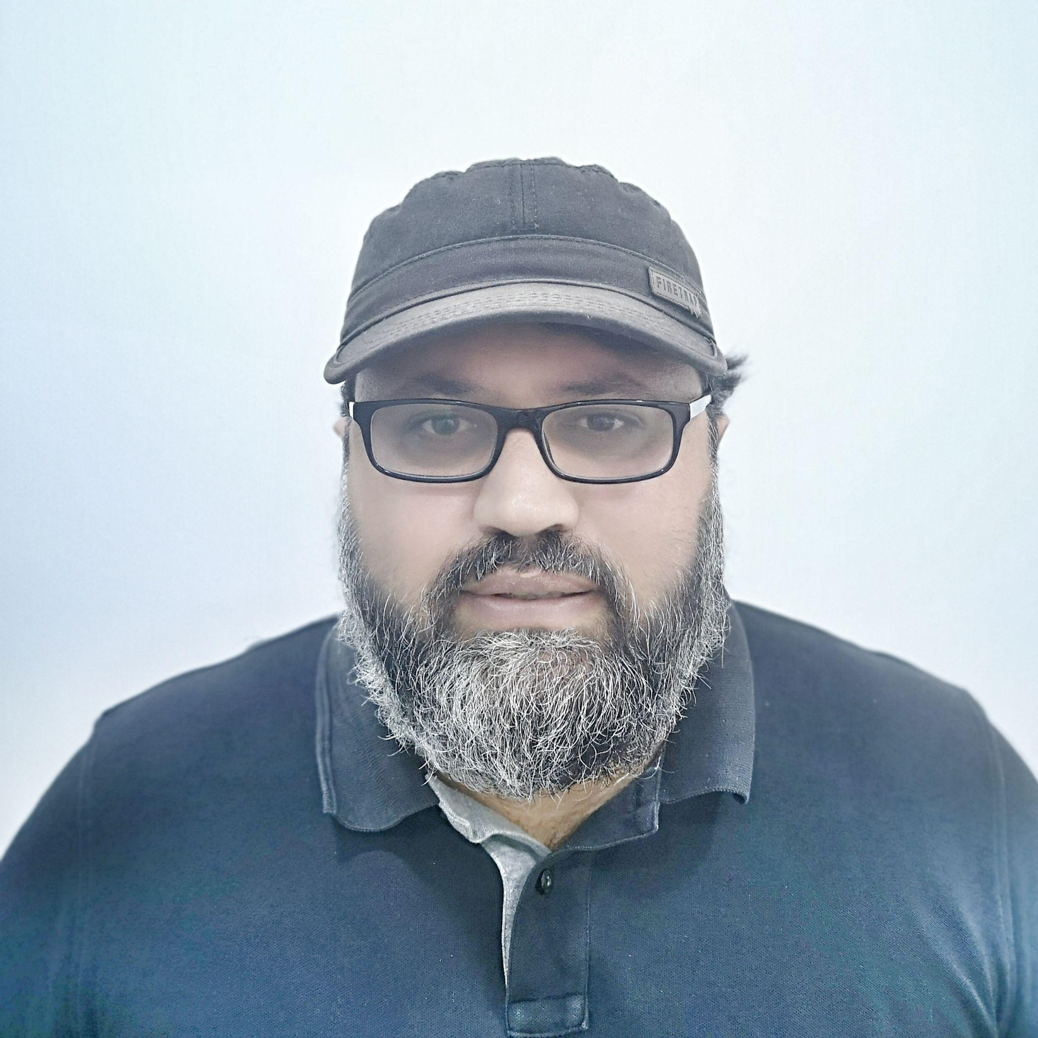
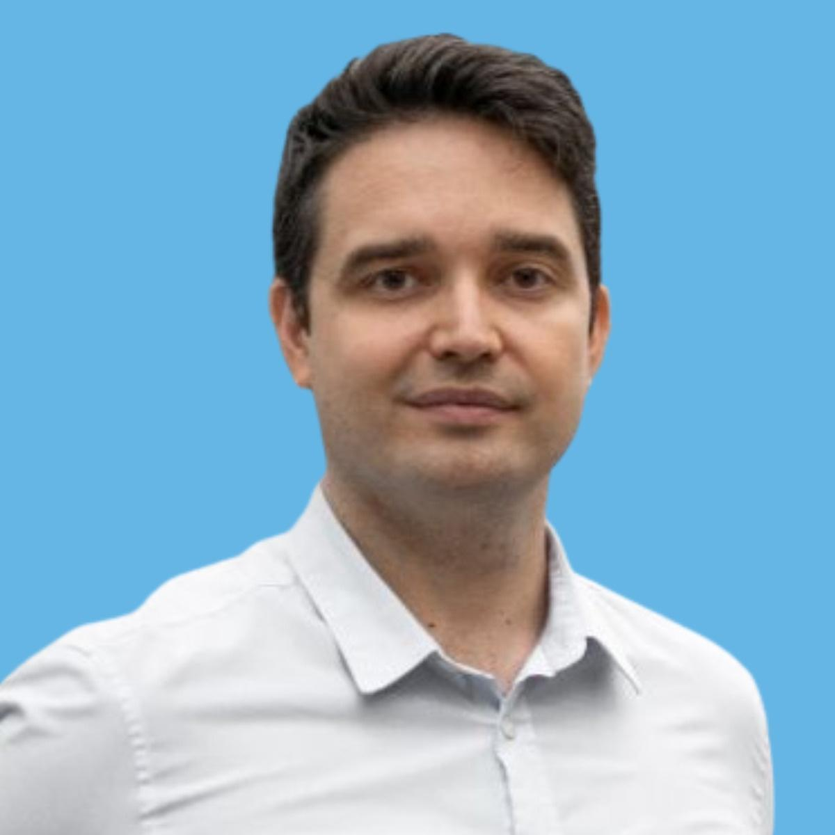
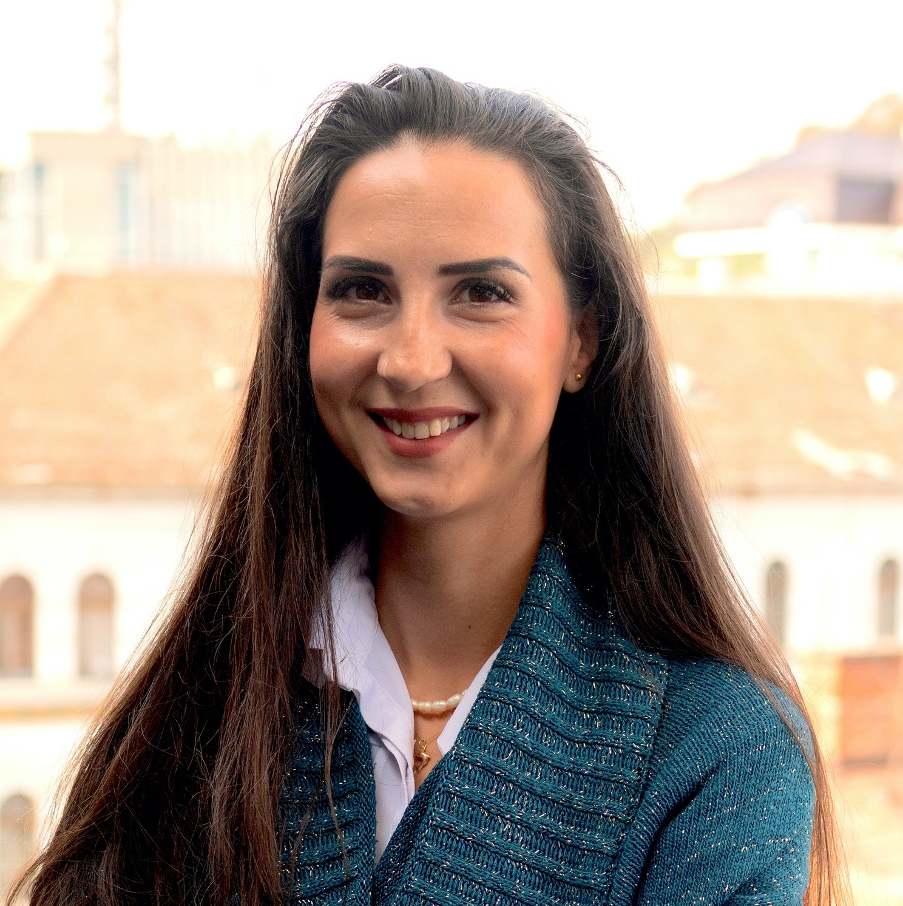
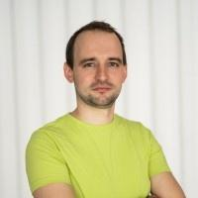
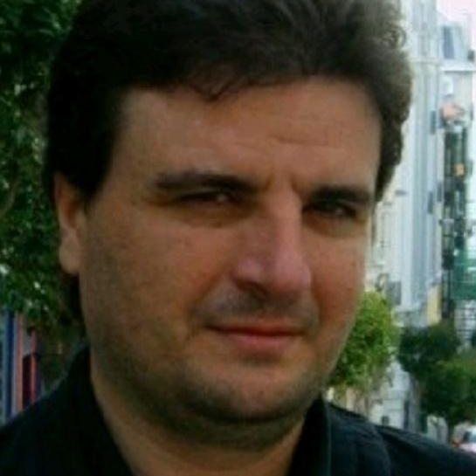
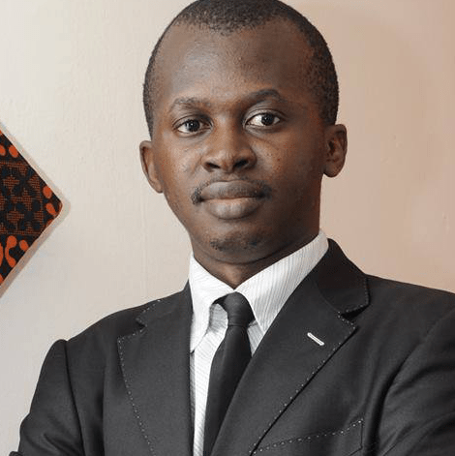
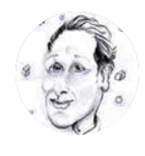
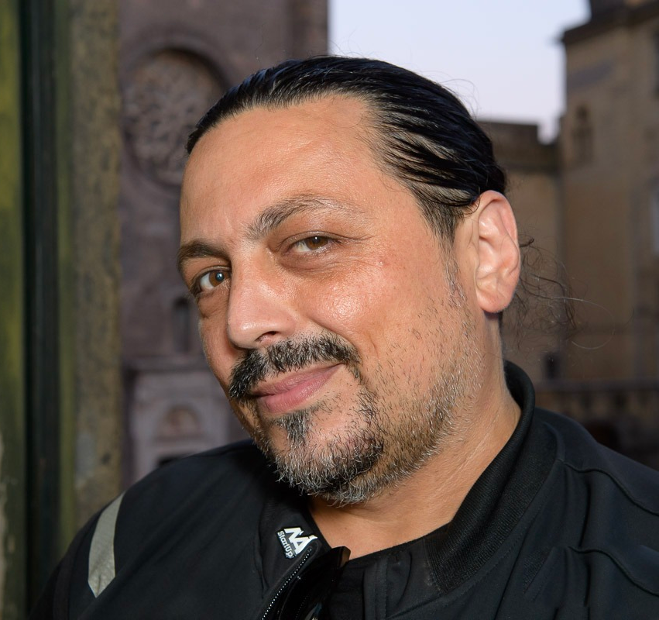
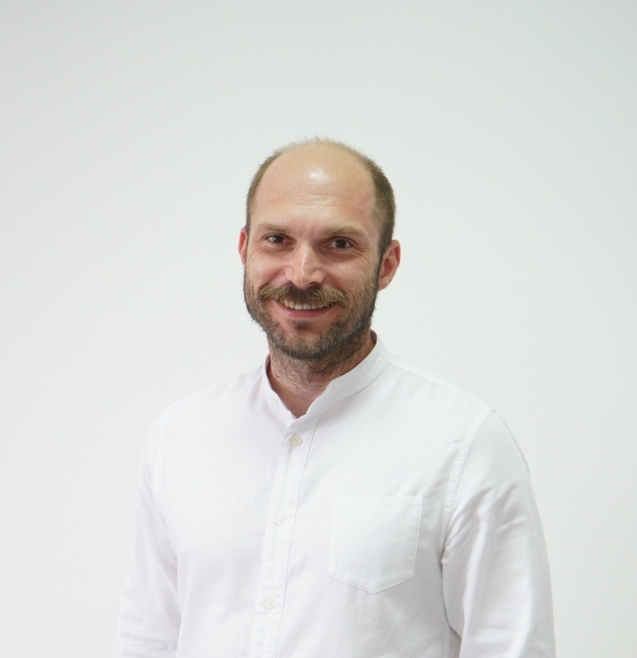
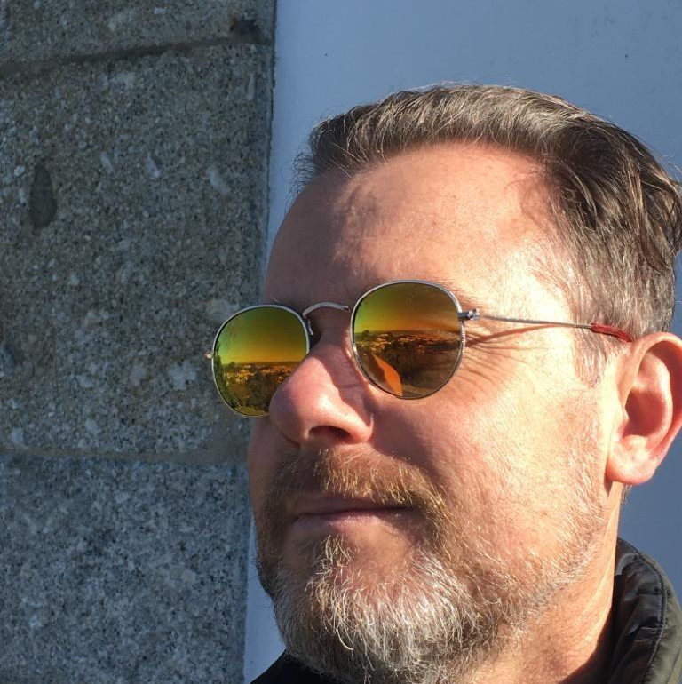
Our amazing Country Organizers
Athina Kaltsiki Greece
Panis Pieri Cyprus
Balazs Horvath Hungary
Cristiana Bogățeanu Romania
Jan Skok Slovenia
Juan Perez Torralbo
Spain
Bacely YoroBi France
Steve Glange Luxembourg
Antonio Prigiobbo Italy
Sasa Lamza Croatia
Marcelo Resmini Aloisio
Netherlands

Slide 10
The platform

Slide 11
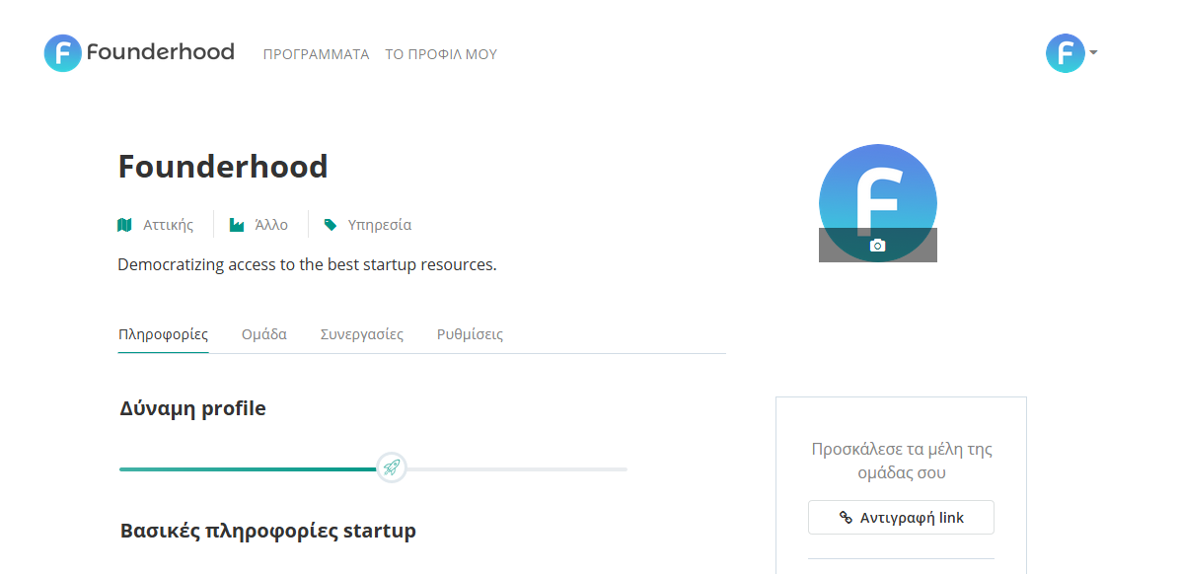
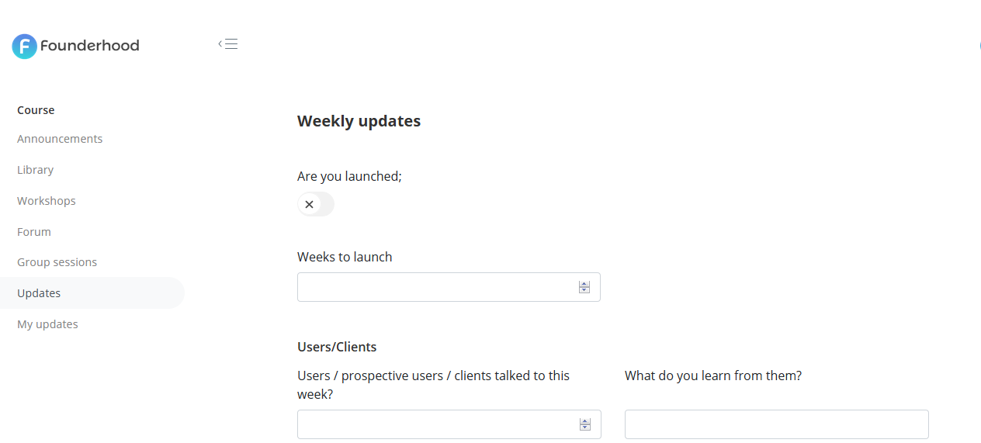
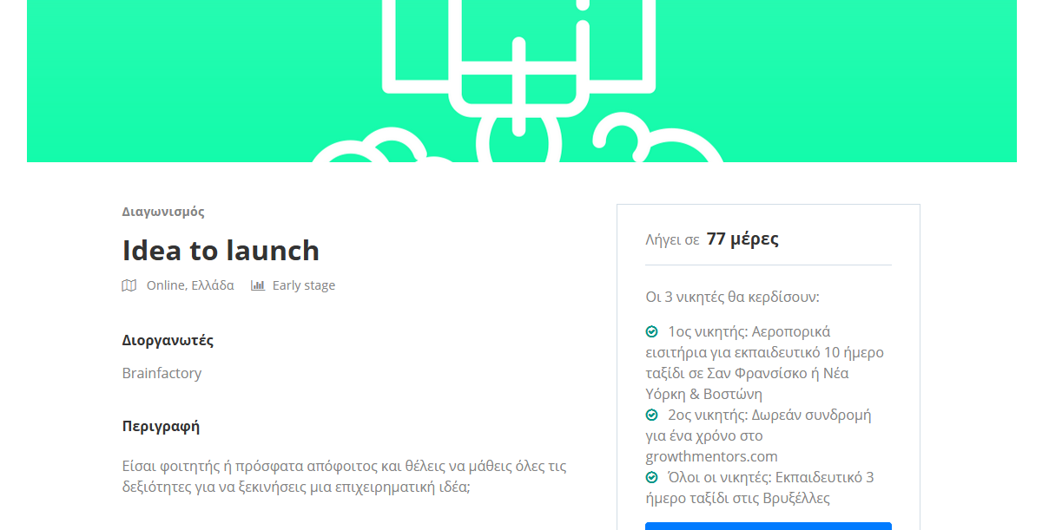
Startup profile
Course weekly updates
Program landing
Startup monitoring

Slide 12
Thanos Paraschos
Join our mission
General Partner
thanos@thefounderhood.com
#Accelerate_EU_tech_ecosystem
+30 694 520 6777
www.thestartupuniverse.org

